Slide 1
Cricket League Score Prediction
Final Project – Group 10
Team Members:
Karunakar Nuvvula
Venkata Tarun Kumar Ambavarapu
Deepak Athota
Ruksana Shaik
Course: CS 667 – Machine Learning (Fall 2025)
Instructor: Dr. Qing Tian, Ph.D.

Slide 2
Motivation
Cricket is highly dynamic → scores change rapidly ball-by-ball
Broadcasting, fantasy leagues & analysts benefit from real-time score predictions
Traditional regression fails to capture nonlinear, context-heavy, temporal patterns
Deep learning enables modeling complex relationships:
  Venue
  Batting/Bowling team
  Player identities
  Match progress (runs, wickets, overs)

Slide 3
Problem Statement
Predict the final score of an IPL innings using ball-by-ball contextual data.
Input Features:
  Venue
  Batting team
  Bowling team
  Batsman & Bowler
  Runs, Wickets
  Overs
  Striker indicator
Output:
  Predicted final score of the innings

Slide 4
Related Work Highlights
Machine Learning in Cricket Analytics:
Bayesian classifiers (Kaluarachchi & Aparna, 2010)
Logistic Regression for ODI prediction (Bandulasiri, 2016)
Random Forest & Gradient Boosting outperform classical models (Bunker & Thabtah, 2019)
Deep Learning:
LSTM models for sequence-based performance prediction (Jayaraman et al., 2020)
Video-based CNN/Transformer models for biomechanics (Pandey & Raj, 2021; Singh & Malhotra, 2022)
Conclusion:
Deep learning → best fit for cricket’s temporal and contextual complexity.

Slide 5
Dataset Overview
IPL Ball-by-Ball Dataset (2008–2017)
Each row = one ball event.
Contains:
Venue, bat_team, bowl_team
Batsman, bowler
Runs, wickets
Overs
Last 5 overs stats
Final total score

Slide 6
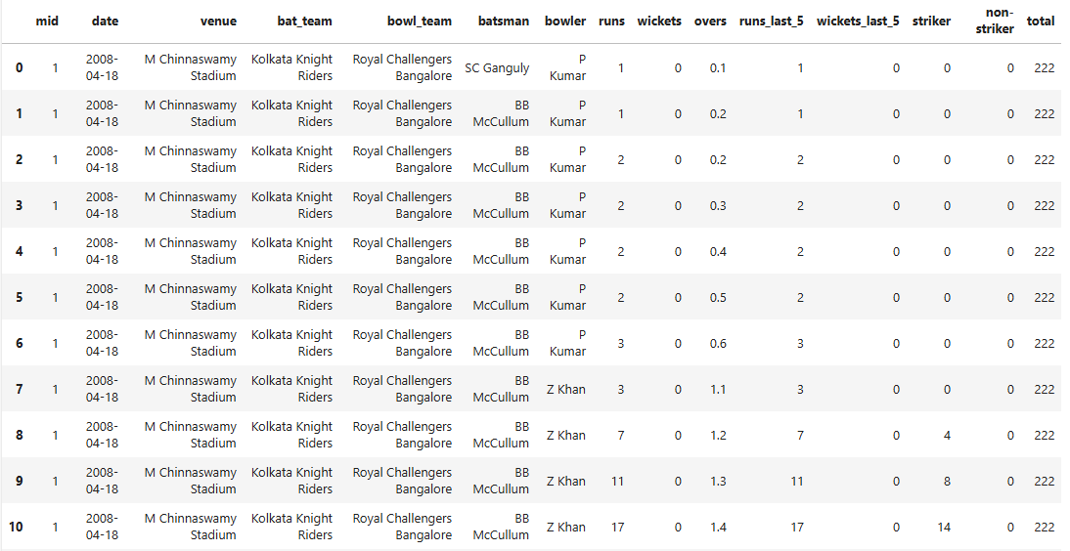
TABLE 1: Basic Dataset Statistics

Slide 7
Data Preprocessing
Removed identifiers: mid, date
Applied Label Encoding to:
  bat_team
  bowl_team
  venue
  batsman
  bowler
Removed correlated features:
  runs_last_5
  wickets_last_5
  non_striker
Applied Min-Max Scaling to all numeric features

Slide 8
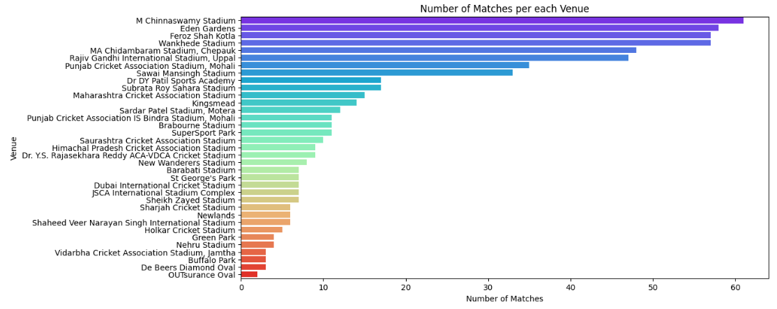
Exploratory Data Analysis (EDA)
FIGURE 1: Number of Matches per each Venue

Slide 9
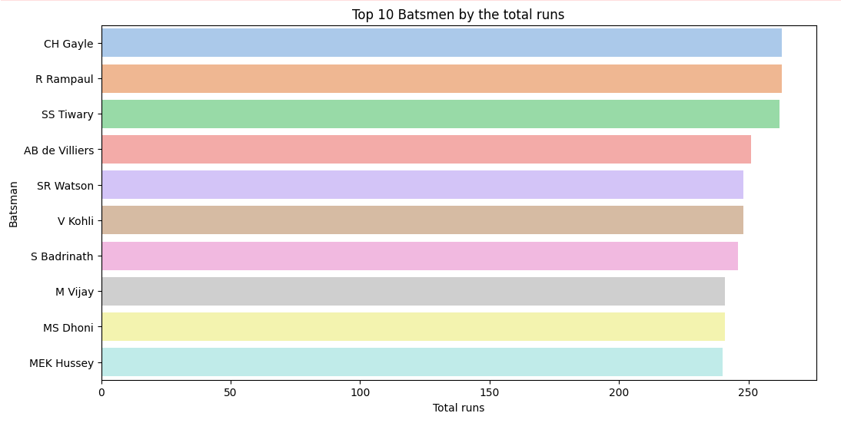
FIGURE 2: Top 10 Batsmen by total runs

Slide 10
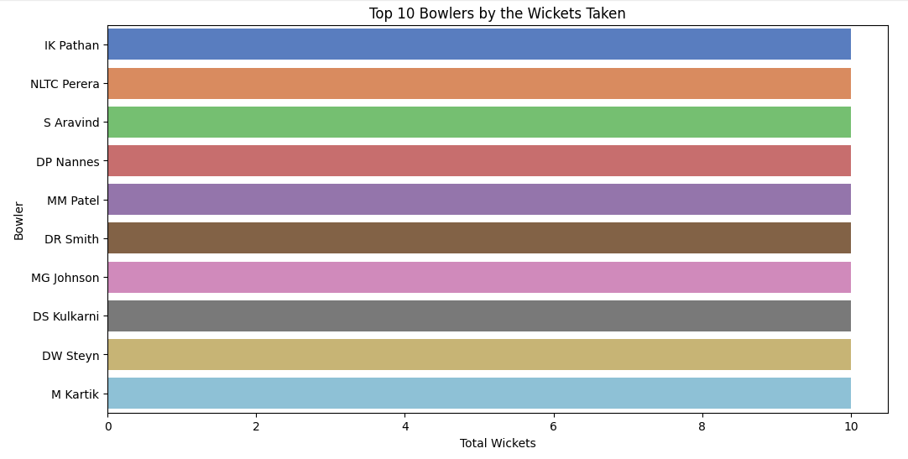
FIGURE 3: Top 10 Bowlers by the total wickets taken

Slide 11
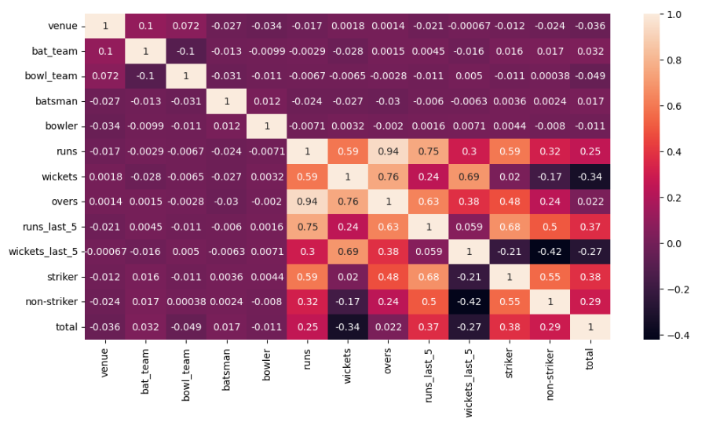
Feature Correlation
FIGURE 4: Correlation Heatmap of Features
Key observations:
Strong correlation among: runs, overs, wickets, last_5 stats
Removed redundant features to reduce multicollinearity
Final feature vector size: 9 inputs

Slide 12
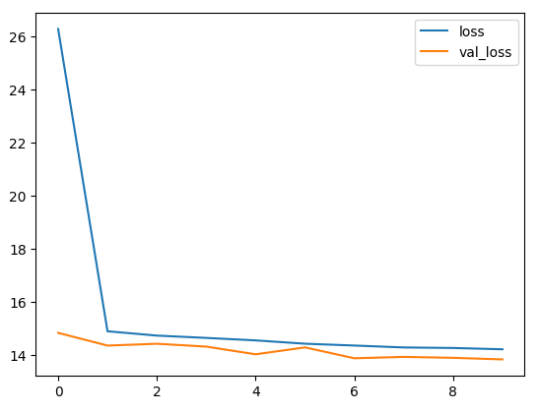
Deep Neural Network Architecture
Model Structure:
Input Layer: 9 features
Hidden Layer 1: 512 neurons, ReLU
Hidden Layer 2: 216 neurons, ReLU
Output Layer: 1 neuron (linear)
Training Details:
Loss: Huber Loss
Optimizer: Adam
Batch Size: 64
Epochs: 10
FIGURE 5: Model Training Loss vs Validation Loss Curve

Slide 13
Results & Evaluation
Mean Absolute Error (MAE):
➡️ ~14.35 runs
Good alignment with research benchmarks (10–15 runs)
Converged within first 5 epochs
Stable performance on test data

Slide 14
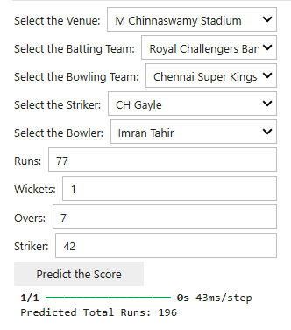
Interactive Score Prediction Widget
Built using ipywidgets for real-time scoring.
Example prediction:
Total Runs Predicted is: 196 for the input scenario shown in below screenshot (Royal Challengers Bangalore vs Chennai Super Kings at M Chinnaswamy Stadium).
FIGURE 6: Screenshot of Interactive Prediction Widget

Slide 15
Conclusion
Key Findings:
Deep learning effectively models cricket scoring dynamics
Label encoding + DNN + Huber Loss → strong accuracy
MAE of ~14 runs is competitive with state-of-the-art
Future Work:
LSTM/GRU to include sequence information
Add contextual features: pitch, weather, player form
Explainable AI (SHAP/LIME)
Update dataset (2018–2024 IPL seasons)

Slide 16
Thank You

